Slide 1
Neurónové siete pre počítačové videnie šk.r. 2019-20
10 Generative Models
Doc. RNDr. Milan Ftáčnik, CSc.
RNDr. Zuzana Černeková, PhD.

Slide 2
Overview
Unsupervised Learning
Generative Models
  PixelRNN and PixelCNN
  Variational Autoencoders (VAE)
  Generative Adversarial Networks (GAN)

Slide 3
Supervised vs Unsupervised Learning
Supervised Learning
Data: (x, y)
x is data, y is label
Goal: Learn a function to map x -> y
Examples: Classification, regression, object detection, semantic segmentation, image captioning, etc.

Slide 4
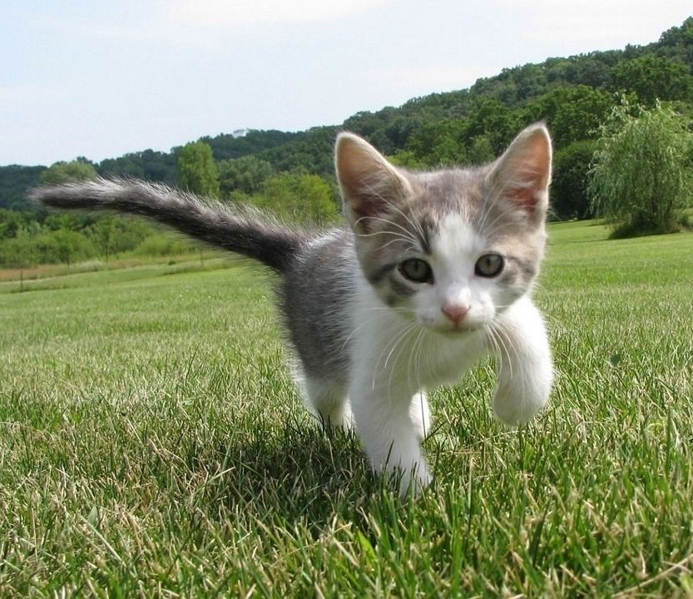
Supervised vs Unsupervised Learning
Supervised Learning
Data: (x, y)
x is data, y is label
Goal: Learn a function to map x -> y
Examples: Classification, regression, object detection, semantic segmentation, image captioning, etc.
Cat
Classification

Slide 5
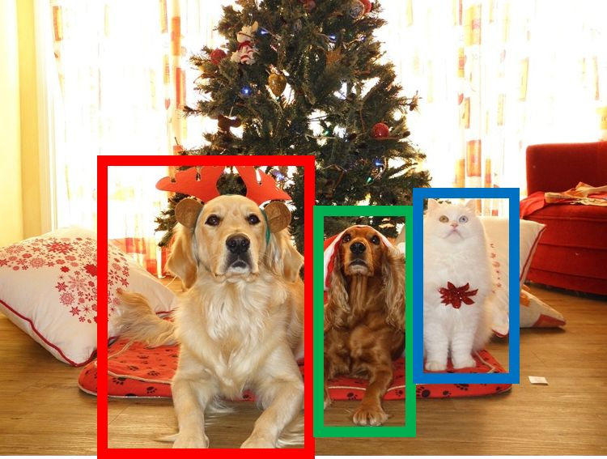
Supervised vs Unsupervised Learning
Supervised Learning
Data: (x, y)
x is data, y is label
Goal: Learn a function to map x -> y
Examples: Classification, regression, object detection, semantic segmentation, image captioning, etc.
DOG, DOG, CAT
Object Detection

Slide 6
Supervised vs Unsupervised Learning
Supervised Learning
Data: (x, y)
x is data, y is label
Goal: Learn a function to map x -> y
Examples: Classification, regression, object detection, semantic segmentation, image captioning, etc.
GRASS, CAT, TREE, SKY
Semantic Segmentation

Slide 7

Supervised vs Unsupervised Learning
Supervised Learning
Data: (x, y)
x is data, y is label
Goal: Learn a function to map x -> y
Examples: Classification, regression, object detection, semantic segmentation, image captioning, etc.
A cat sitting on a suitcase on the floor
Image captioning

Slide 8
Supervised vs Unsupervised Learning
Unsupervised Learning
Data: x
Just data, no labels!
Goal: Learn some underlying hidden structure of the data
Examples: Clustering, dimensionality reduction, feature learning, density estimation, etc.

Slide 9
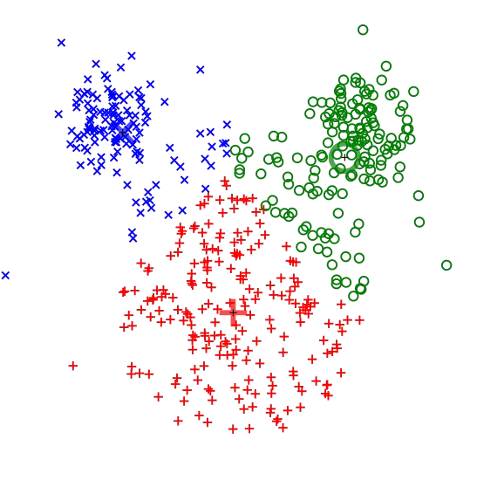
Supervised vs Unsupervised Learning
Unsupervised Learning
Data: x
Just data, no labels!
Goal: Learn some underlying hidden structure of the data
Examples: Clustering, dimensionality reduction, feature learning, density estimation, etc.
K-means clustering

Slide 10
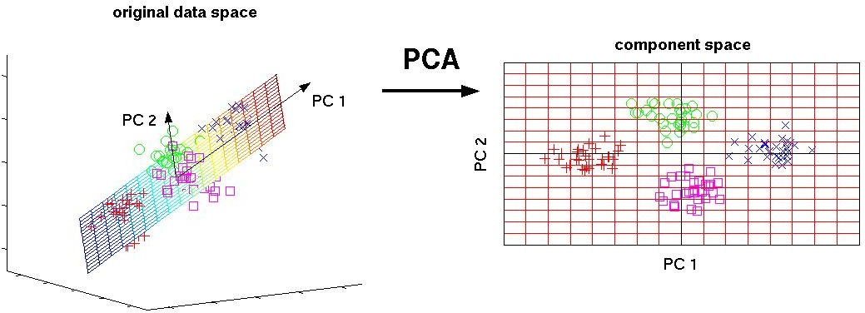
Supervised vs Unsupervised Learning
Unsupervised Learning
Data: x
Just data, no labels!
Goal: Learn some underlying hidden structure of the data
Examples: Clustering, dimensionality reduction, feature learning, density estimation, etc.
3-d 2-d
Principal Component Analysis (Dimensionality reduction)

Slide 11
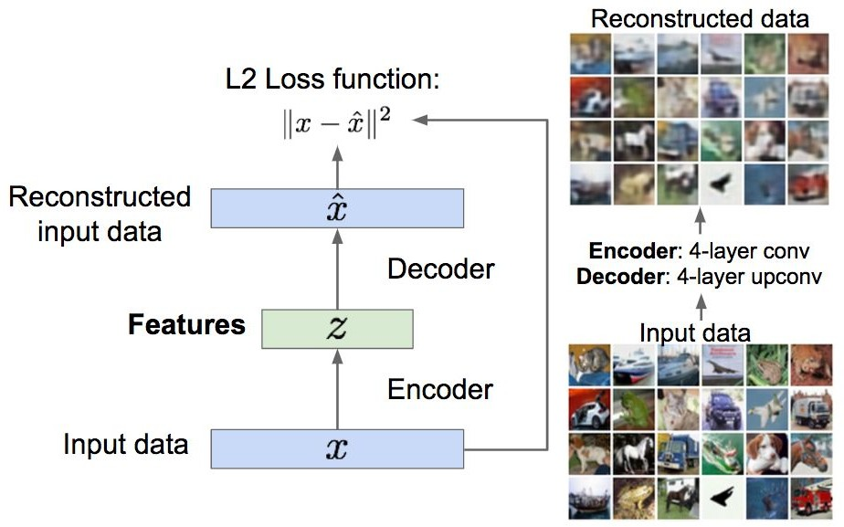
Supervised vs Unsupervised Learning
Unsupervised Learning
Data: x
Just data, no labels!
Goal: Learn some underlying hidden structure of the data
Examples: Clustering, dimensionality reduction, feature learning, density estimation, etc.
Autoencoders (Feature learning)

Slide 12
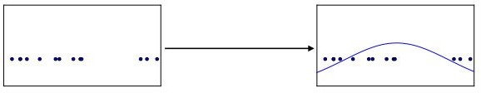
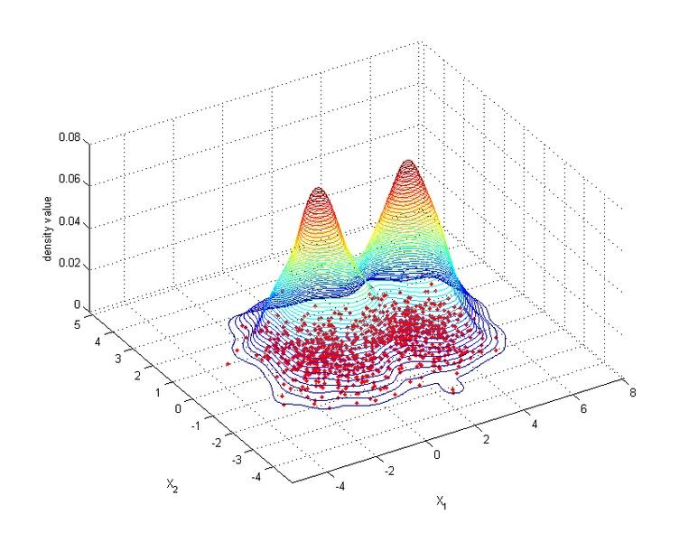
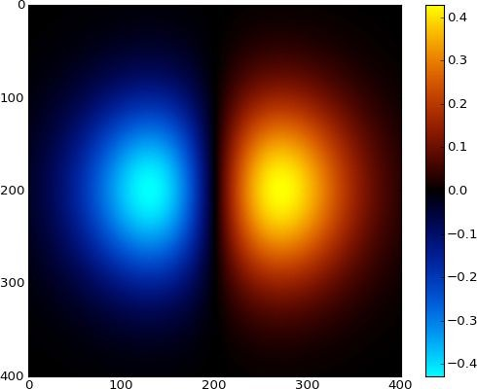
Supervised vs Unsupervised Learning
Unsupervised Learning
Data: x
Just data, no labels!
Goal: Learn some underlying hidden structure of the data
Examples: Clustering, dimensionality reduction, feature learning, density estimation, etc.
Figure copyright Ian Goodfellow, 2016. Reproduced with permission.
1-d density estimation
2-d density estimation

Slide 13
Supervised vs Unsupervised Learning
Supervised Learning
Data: (x, y)
x is data, y is label
Goal: Learn a function to map x -> y
Examples: Classification, regression, object detection, semantic segmentation, image captioning, etc.
Unsupervised Learning
Data: x
Just data, no labels!
Goal: Learn some underlying hidden structure of the data
Examples: Clustering, dimensionality reduction, feature learning, density estimation, etc.

Slide 14
Supervised vs Unsupervised Learning
Supervised Learning
Data: (x, y)
x is data, y is label
Goal: Learn a function to map x -> y
Examples: Classification, regression, object detection, semantic segmentation, image captioning, etc.
Training data is cheap
Unsupervised Learning
Data: x
Just data, no labels!
Goal: Learn some underlying hidden structure of the data
Examples: Clustering, dimensionality reduction, feature learning, density estimation, etc.
Holy grail: Solve unsupervised learning
=> understand structure of visual world

Slide 15






Generative Models
Given training data, generate new samples from same distribution
Training data ~ p_{data}(x) Generated samples ~ p_{model}(x)
Want to learn p_{model}(x) similar to p_{data}(x)

Slide 16
Generative Models
Given training data, generate new samples from same distribution
Addresses density estimation, a core problem in unsupervised learning
Several flavors:
Explicit density estimation: explicitly define and solve for p_{model}(x)
Implicit density estimation: learn model that can sample from p_{model}(x) w/o explicitly defining it
Training data ~ p_{data}(x) Generated samples ~ p_{model}(x)
Want to learn p_{model}(x) similar to p_{data}(x)

Slide 17
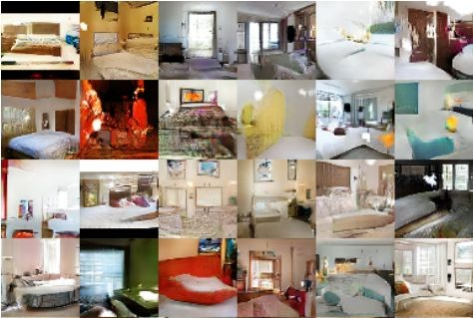
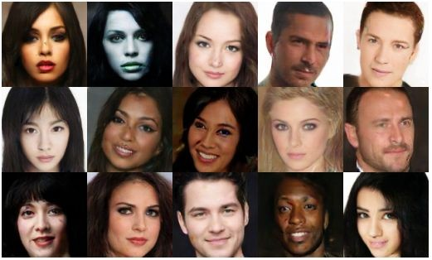
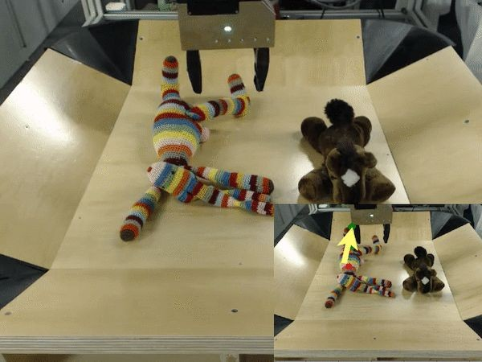
Why Generative Models?
- Realistic samples for artwork, super-resolution, colorization, etc.
Generative models of time-series data can be used for simulation and planning (reinforcement learning applications!)
Training generative models can also enable inference of latent representations that can be useful as general features

Slide 18
Taxonomy of Generative Models
Direct
GAN
Generative models
Explicit density
Implicit density
Tractable density
Approximate density
Markov Chain
Fully Visible Belief Nets
GSN
Variational
Markov Chain
Variational Autoencoder Boltzmann Machine

Slide 19
Taxonomy of Generative Models
Direct
Today: discuss 3 most popular types of generative models today
GAN
Generative models
Explicit density
Implicit density
Tractable density
Approximate density
Markov Chain
Fully Visible Belief Nets
GSN
NADE
MADE
PixelRNN/CNN
NICE / RealNVP
Glow
Ffjord
Variational
Markov Chain
Variational Autoencoder Boltzmann Machine

Slide 20
PixelRNN and PixelCNN

Slide 21

Fully visible belief network
Explicit density model
Use chain rule to decompose likelihood of an image x into product of 1D distributions:
Likelihood of image x
Probability of i’th pixel value given all previous pixels
Then maximize likelihood of training data

Slide 22
Fully visible belief network
Explicit density model
Use chain rule to decompose likelihood of an image x into product of 1D distributions:
Likelihood of image x
Probability of i’th pixel value given all previous pixels
Complex distribution over pixel
values => Express using a neural network!
Then maximize likelihood of training data

Slide 23
Fully visible belief network
Explicit density model
Use chain rule to decompose likelihood of an image x into product of 1D distributions:
Will need to define ordering of “previous pixels”
Likelihood of image x
Probability of i’th pixel value given all previous pixels
Complex distribution over pixel
values => Express using a neural network!
Then maximize likelihood of training data

Slide 24







PixelRNN
[van der Oord et al. 2016]
Generate image pixels starting from corner
Dependency on previous pixels modeled using an RNN (LSTM)

Slide 25
PixelRNN
[van der Oord et al. 2016]
Generate image pixels starting from corner
Dependency on previous pixels modeled using an RNN (LSTM)

Slide 26



PixelRNN
[van der Oord et al. 2016]
Generate image pixels starting from corner
Dependency on previous pixels modeled using an RNN (LSTM)

Slide 27
PixelRNN
[van der Oord et al. 2016]
Generate image pixels starting from corner
Dependency on previous pixels modeled using an RNN (LSTM)
Drawback: sequential generation is slow!

Slide 28
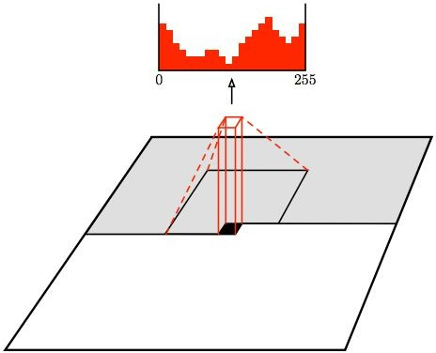
PixelCNN
[van der Oord et al. 2016]
Softmax loss at each pixel
Still generate image pixels starting from corner
Dependency on previous pixels now modeled using a CNN over context region

Slide 29
PixelCNN
[van der Oord et al. 2016]
Softmax loss at each pixel
Still generate image pixels starting from corner
Dependency on previous pixels now modeled using a CNN over context region
Training: maximize likelihood of training images

Slide 30
PixelCNN
[van der Oord et al. 2016]
Softmax loss at each pixel
Still generate image pixels starting from corner
Dependency on previous pixels now modeled using a CNN over context region
Training is faster than PixelRNN
(can parallelize convolutions since context region values known from training images)
Generation must still proceed sequentially
=> still slow

Slide 31
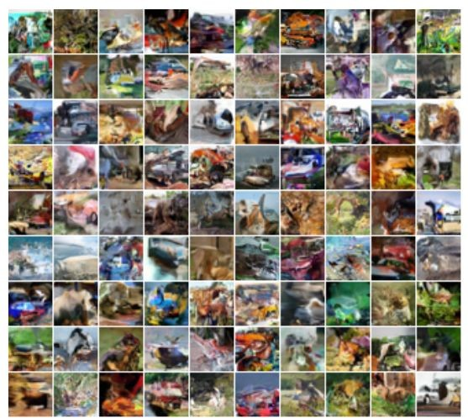
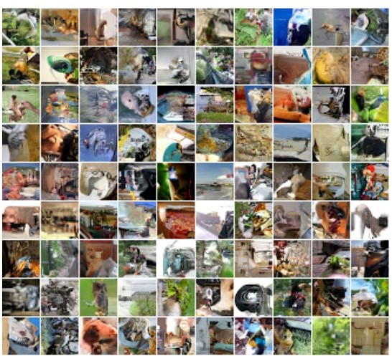
Generation Samples
32x32 CIFAR-10
32x32 ImageNet

Slide 32
PixelRNN and PixelCNN
Pros:
Can explicitly compute likelihood p(x)
Explicit likelihood of training data gives good evaluation metric
Good samples
Con:
Sequential generation => slow
Improving PixelCNN performance
Gated convolutional layers
Short-cut connections
Discretized logistic loss
Multi-scale
Training tricks
Etc…
Van der Oord et al. NIPS 2016
Salimans et al. 2017 (PixelCNN++)
See

Slide 33
Variational Autoencoders (VAE)

Slide 34
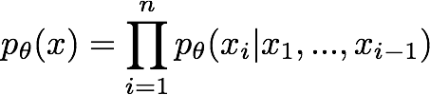
So far...
PixelCNNs define tractable density function, optimize likelihood of training data:

Slide 35

So far...
PixelCNNs define tractable density function, optimize likelihood of training data:
VAEs define intractable density function with latent z:
Cannot optimize directly, derive and optimize lower bound on likelihood instead

Slide 36
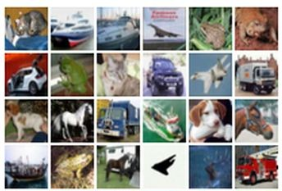
Some background first: Autoencoders
Unsupervised approach for learning a lower-dimensional feature representation from unlabeled training data
Features
Encoder
Input data

Slide 37
Some background first: Autoencoders
Unsupervised approach for learning a lower-dimensional feature representation from unlabeled training data
Originally: Linear + nonlinearity (sigmoid)
Later: Deep, fully-connected
Later: ReLU CNN
Features
Encoder
Input data

Slide 38
Some background first: Autoencoders
Unsupervised approach for learning a lower-dimensional feature representation from unlabeled training data
z usually smaller than x
(dimensionality reduction)
Originally: Linear + nonlinearity (sigmoid)
Later: Deep, fully-connected
Later: ReLU CNN
Q: Why dimensionality reduction?
Features
Encoder
Input data

Slide 39
Some background first: Autoencoders
Unsupervised approach for learning a lower-dimensional feature representation from unlabeled training data
z usually smaller than x
(dimensionality reduction)
Originally: Linear + nonlinearity (sigmoid)
Later: Deep, fully-connected
Later: ReLU CNN
Q: Why dimensionality reduction?
A: Want features to capture meaningful factors of variation in data
Features
Encoder
Input data

Slide 40
Some background first: Autoencoders
How to learn this feature representation?
Features
Encoder
Input data

Slide 41
Some background first: Autoencoders
How to learn this feature representation?
Train such that features can be used to reconstruct original data “Autoencoding” - encoding itself
Reconstructed input data
Features
Encoder
Input data

Slide 42
Some background first: Autoencoders
How to learn this feature representation?
Train such that features can be used to reconstruct original data “Autoencoding” - encoding itself
Originally: Linear +
Reconstructed input data
nonlinearity (sigmoid)
Later: Deep, fully-connected
Later: ReLU CNN (upconv)
Features
Encoder
Input data

Slide 43
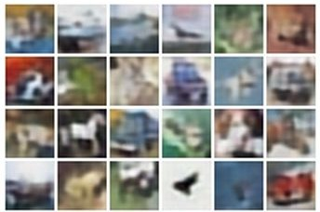
Some background first: Autoencoders
Reconstructed data
How to learn this feature representation?
Train such that features can be used to reconstruct original data “Autoencoding” - encoding itself
Reconstructed input data
Encoder: 4-layer conv
Decoder: 4-layer upconv
Decoder
Input data
Features
Encoder
Input data

Slide 44

Some background first: Autoencoders
Train such that features
Reconstructed data
can be used to reconstruct original data
L2 Loss function:
Reconstructed input data
Encoder: 4-layer conv
Decoder: 4-layer upconv
Decoder
Input data
Features
Encoder
Input data

Slide 45
Some background first: Autoencoders
Train such that features
Doesn’t use labels!
Reconstructed data
can be used to reconstruct original data
L2 Loss function:
Reconstructed input data
Encoder: 4-layer conv
Decoder: 4-layer upconv
Decoder
Input data
Features
Encoder
Input data

Slide 46
Some background first: Autoencoders
Reconstructed input data
Decoder
Features
After training,
throw away decoder
Encoder
Input data

Slide 47

Some background first: Autoencoders
Encoder can be used to initialize a supervised model
Loss function (Softmax, etc)
bird
plane
dog
deer
truck
Predicted Label
Classifier
Fine-tune encoder jointly with classifier
Train for final task (sometimes with small data)
Features
Encoder
Input data

Slide 48
Some background first: Autoencoders
Autoencoders can reconstruct data, and can learn features to initialize a supervised model
Features capture factors of variation in training data. Can we generate new images from an autoencoder?
Reconstructed input data
Decoder
Features
Encoder
Input data

Slide 49
Variational Autoencoders
Probabilistic spin on autoencoders - will let us sample from the model to generate data!

Slide 50



Variational Autoencoders
Probabilistic spin on autoencoders - will let us sample from the model to generate data!
Assume training data is generated from underlying unobserved (latent) representation z
Sample from true conditional
Sample from true prior
Kingma and Welling, “Auto-Encoding Variational Bayes”, ICLR 2014

Slide 51
Variational Autoencoders
Probabilistic spin on autoencoders - will let us sample from the model to generate data!
Assume training data is generated from underlying unobserved (latent) representation z
Intuition (remember from autoencoders!): x is an image, z is latent factors used to generate x: attributes, orientation, etc.
Sample from true conditional
Sample from true prior
Kingma and Welling, “Auto-Encoding Variational Bayes”, ICLR 2014

Slide 52
Variational Autoencoders
We want to estimate the true parameters of this generative model.
Sample from true conditional
Sample from true prior
Kingma and Welling, “Auto-Encoding Variational Bayes”, ICLR 2014

Slide 53
Variational Autoencoders
We want to estimate the true parameters of this generative model.
Sample from true conditional
How should we represent this model?
Sample from true prior
Kingma and Welling, “Auto-Encoding Variational Bayes”, ICLR 2014

Slide 54
Variational Autoencoders
We want to estimate the true parameters of this generative model.
Sample from true conditional
How should we represent this model?
Choose prior p(z) to be simple, e.g. Gaussian. Reasonable for latent attributes,
e.g. pose, how much smile.
Sample from true prior
Kingma and Welling, “Auto-Encoding Variational Bayes”, ICLR 2014

Slide 55
Variational Autoencoders
We want to estimate the true parameters of this generative model.
Sample from true conditional
How should we represent this model?
Choose prior p(z) to be simple, e.g. Gaussian.
Conditional p(x|z) is complex (generates image) => represent with neural network
Decoder network
Sample from true prior
Kingma and Welling, “Auto-Encoding Variational Bayes”, ICLR 2014

Slide 56
Variational Autoencoders
We want to estimate the true parameters of this generative model.
Sample from true conditional
How to train the model?
Decoder network
Sample from true prior
Kingma and Welling, “Auto-Encoding Variational Bayes”, ICLR 2014

Slide 57

Variational Autoencoders
We want to estimate the true parameters of this generative model.
Sample from true conditional
How to train the model?
Decoder network
Remember strategy for training generative models from FVBNs. Learn model parameters to maximize likelihood of training data
Sample from true prior
Now with latent z
Kingma and Welling, “Auto-Encoding Variational Bayes”, ICLR 2014

Slide 58
Variational Autoencoders
We want to estimate the true parameters of this generative model.
Sample from true conditional
How to train the model?
Decoder network
Remember strategy for training generative models from FVBNs. Learn model parameters to maximize likelihood of training data
Sample from true prior
Q: What is the problem with this?
Kingma and Welling, “Auto-Encoding Variational Bayes”, ICLR 2014

Slide 59
Variational Autoencoders
We want to estimate the true parameters of this generative model.
Sample from true conditional
How to train the model?
Decoder network
Remember strategy for training generative models from FVBNs. Learn model parameters to maximize likelihood of training data
Sample from true prior
Q: What is the problem with this?
Intractable!
Kingma and Welling, “Auto-Encoding Variational Bayes”, ICLR 2014

Slide 60
Variational Autoencoders: Intractability
Data likelihood:
Posterior density also intractable:

Slide 61
Variational Autoencoders: Intractability
Data likelihood:
Posterior density also intractable:
Solution: In addition to decoder network modeling p_{θ}(x|z), define additional encoder network q_{ɸ}(z|x) that approximates p_{θ}(z|x)
Will see that this allows us to derive a lower bound on the data likelihood that is tractable, which we can optimize

Slide 62




Variational Autoencoders
Since we’re modeling probabilistic generation of data, encoder and decoder networks are probabilistic
Mean and (diagonal) covariance of z | x Mean and (diagonal) covariance of x | z
Encoder network
Decoder network
(parameters ɸ)
(parameters θ)
Kingma and Welling, “Auto-Encoding Variational Bayes”, ICLR 2014

Slide 63


Variational Autoencoders
Since we’re modeling probabilistic generation of data, encoder and decoder networks are probabilistic
Sample z from
Sample x from
Encoder network
Decoder network
(parameters ɸ)
(parameters θ)
Kingma and Welling, “Auto-Encoding Variational Bayes”, ICLR 2014

Slide 64
Variational Autoencoders
Since we’re modeling probabilistic generation of data, encoder and decoder networks are probabilistic
Sample z from
Sample x from
Encoder network
Decoder network
(parameters ɸ)
(parameters θ)
Encoder and decoder networks also called “recognition”/“inference” and “generation” networks
Kingma and Welling, “Auto-Encoding Variational Bayes”, ICLR 2014

Slide 65
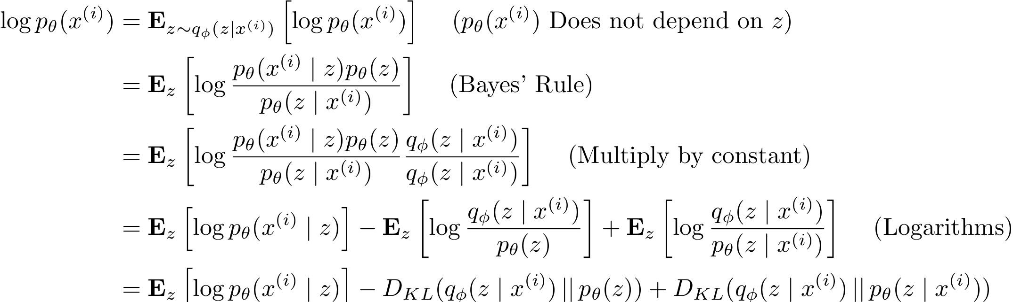
Variational Autoencoders
Now equipped with our encoder and decoder networks, let’s work out the (log) data likelihood:
Encoder network
Decoder network gives p_{θ}(x|z), can
compute estimate of this term through sampling. (Sampling differentiable through reparam. trick, see paper.)
This KL (Kullback–Leibler divergence) term (between Gaussians for encoder and z prior) has nice closed-form solution!
p_{θ}(z|x) intractable (saw
earlier), can’t compute this KL term :( But we know KL divergence always >= 0.

Slide 66


Variational Autoencoders
Now equipped with our encoder and decoder networks, let’s work out the (log) data likelihood:
We want to maximize the data likelihood
Tractable lower bound which we can take gradient of and optimize! (p_{θ}(x|z) differentiable,
KL term differentiable)

Slide 67
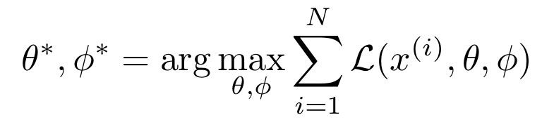

Variational Autoencoders
Now equipped with our encoder and decoder networks, let’s work out the (log) data likelihood:
We want to maximize the data likelihood
Variational lower bound (“ELBO”)
Training: Maximize lower bound

Slide 68
Variational Autoencoders
Now equipped with our encoder and decoder networks, let’s work out the (log) data likelihood:
Make approximate posterior distribution close to prior
Reconstruct the input data
Variational lower bound (“ELBO”)
Training: Maximize lower bound

Slide 69
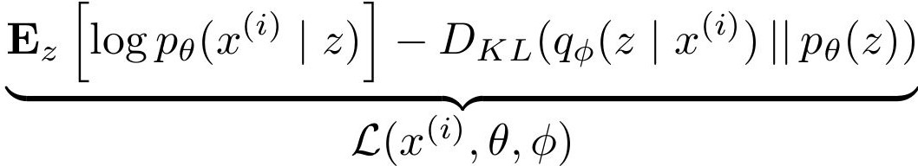
Variational Autoencoders
Putting it all together: maximizing the likelihood lower bound
Maximize
likelihood of original input being reconstructed
Sample x|z from
Decoder network
Sample z from
Make approximate posterior distribution close to prior
Encoder network
For every minibatch of input data: compute this forward pass, and then backprop!
Input Data

Slide 70

Variational Autoencoders: Generating Data!
Use decoder network. Now sample z from prior!
Sample x|z from
Decoder network
Sample z from
Kingma and Welling, “Auto-Encoding Variational Bayes”, ICLR 2014

Slide 71
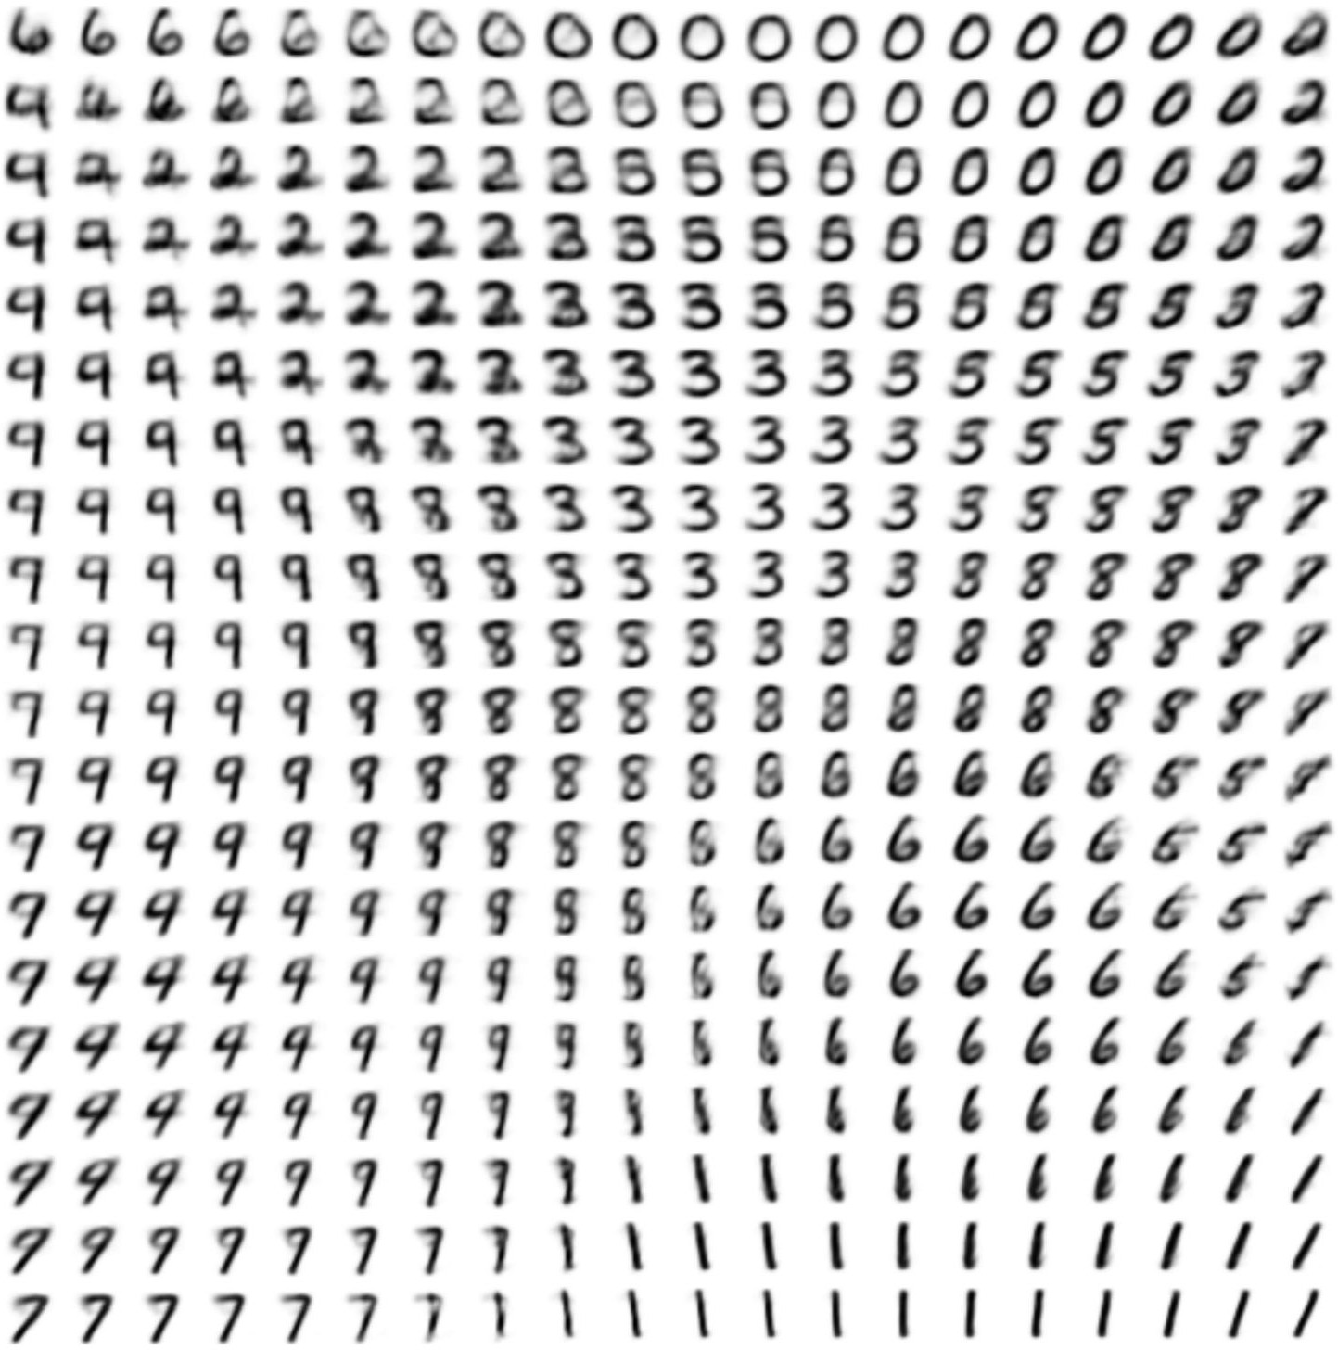
Variational Autoencoders: Generating Data!
Use decoder network. Now sample z from prior!
Sample x|z from
Decoder network
Sample z from
Kingma and Welling, “Auto-Encoding Variational Bayes”, ICLR 2014

Slide 72
Variational Autoencoders: Generating Data!
Data manifold for 2-d z
Use decoder network. Now sample z from prior!
Sample x|z from
Vary z₁
Decoder network
Sample z from
Kingma and Welling, “Auto-Encoding Variational Bayes”, ICLR 2014
Vary z₂

Slide 73
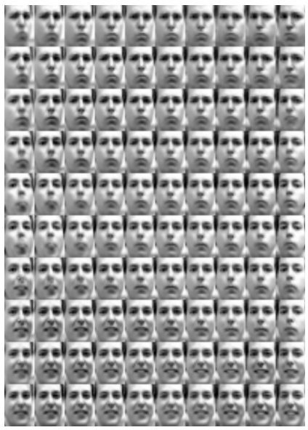
Variational Autoencoders: Generating Data!
Diagonal prior on z
=> independent latent variables
Degree of smile
Different dimensions of z encode interpretable factors of variation
Vary z₁
Vary z
Head pose
2

Slide 74

Variational Autoencoders: Generating Data!
Diagonal prior on z
=> independent latent variables
Degree of smile
Different dimensions of z encode interpretable factors of variation
Vary z₁
Also good feature representation that can be computed using q_{ɸ}(z|x)!
Vary z
Head pose
2

Slide 75
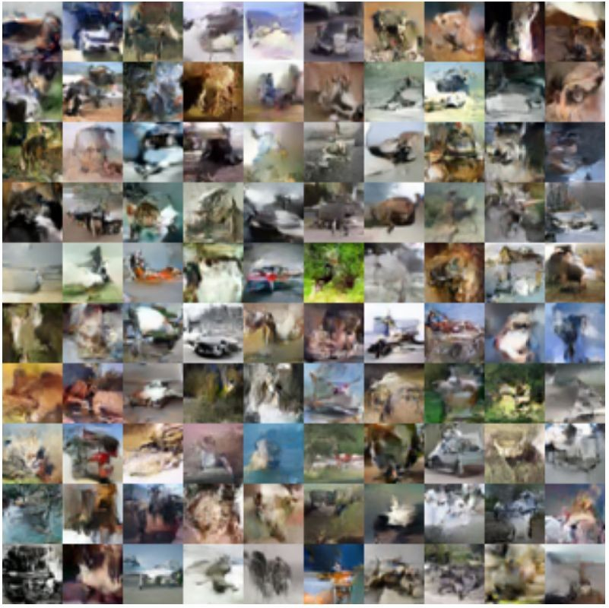
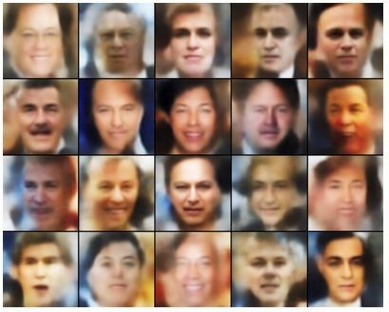
Variational Autoencoders: Generating Data!
Labeled Faces in the Wild
32x32 CIFAR-10

Slide 76
Variational Autoencoders
Probabilistic spin to traditional autoencoders => allows generating data
Defines an intractable density => derive and optimize a (variational) lower bound
Pros:
Principled approach to generative models
Allows inference of q(z|x), can be useful feature representation for other tasks
Cons:
Maximizes lower bound of likelihood: okay, but not as good evaluation as PixelRNN/PixelCNN
Samples blurrier and lower quality compared to state-of-the-art (GANs)
Active areas of research:
More flexible approximations, e.g. richer approximate posterior instead of diagonal Gaussian, e.g., Gaussian Mixture Models (GMMs)
Incorporating structure in latent variables, e.g., Categorical Distributions

Slide 77
Generative Adversarial Networks (GAN)

Slide 78
So far...
PixelCNNs define tractable density function, optimize likelihood of training data:
VAEs define intractable density function with latent z:
Cannot optimize directly, derive and optimize lower bound on likelihood instead
What if we give up on explicitly modeling density, and just want ability to sample?

Slide 79
So far...
PixelCNNs define tractable density function, optimize likelihood of training data:
VAEs define intractable density function with latent z:
Cannot optimize directly, derive and optimize lower bound on likelihood instead
What if we give up on explicitly modeling density, and just want ability to sample?
GANs: don’t work with any explicit density function!
Instead, take game-theoretic approach: learn to generate from training distribution through 2-player game

Slide 80
Generative Adversarial Networks
Problem: Want to sample from complex, high-dimensional training distribution. No direct way to do this!
Solution: Sample from a simple distribution, e.g. random noise. Learn transformation to training distribution.
Q: What can we use to represent this complex transformation?
Ian Goodfellow et al., “Generative Adversarial Nets”, NIPS 2014

Slide 81
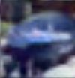
Generative Adversarial Networks
Problem: Want to sample from complex, high-dimensional training distribution. No direct way to do this!
Solution: Sample from a simple distribution, e.g. random noise. Learn transformation to training distribution.
Q: What can we use to represent this complex transformation?
Output: Sample from training distribution
Generator Network
A: A neural network!
Input: Random noise
z
Ian Goodfellow et al., “Generative Adversarial Nets”, NIPS 2014

Slide 82
Training GANs: Two-player game
Generator network: try to fool the discriminator by generating real-looking images
Discriminator network: try to distinguish between real and fake images
Ian Goodfellow et al., “Generative Adversarial Nets”, NIPS 2014

Slide 83





Training GANs: Two-player game
Generator network: try to fool the discriminator by generating real-looking images
Discriminator network: try to distinguish between real and fake images
Real or Fake
Discriminator Network
Fake Images (from generator)
Real Images (from training set)
Generator Network
Random noise
z
Ian Goodfellow et al., “Generative Adversarial Nets”, NIPS 2014

Slide 84
Training GANs: Two-player game
Generator network: try to fool the discriminator by generating real-looking images
Discriminator network: try to distinguish between real and fake images
Train jointly in minimax game
Minimax objective function:
Ian Goodfellow et al., “Generative Adversarial Nets”, NIPS 2014

Slide 85
Training GANs: Two-player game
Generator network: try to fool the discriminator by generating real-looking images
Discriminator network: try to distinguish between real and fake images
Train jointly in minimax game
Discriminator outputs likelihood in (0,1) of real image
Minimax objective function:
Discriminator output for real data x
Discriminator output for generated fake data G(z)
Ian Goodfellow et al., “Generative Adversarial Nets”, NIPS 2014

Slide 86
Training GANs: Two-player game
Generator network: try to fool the discriminator by generating real-looking images
Discriminator network: try to distinguish between real and fake images
Train jointly in minimax game
Discriminator outputs likelihood in (0,1) of real image
Minimax objective function:
Discriminator output for real data x
Discriminator output for generated fake data G(z)
Discriminator (θ_{d}) wants to maximize objective such that D(x) is close to 1 (real) and D(G(z)) is close to 0 (fake)
Generator (θ_{g}) wants to minimize objective such that D(G(z)) is close to 1 (discriminator is fooled into thinking generated G(z) is real)
Ian Goodfellow et al., “Generative Adversarial Nets”, NIPS 2014

Slide 87

Training GANs: Two-player game
Minimax objective function:
Alternate between:
1. Gradient ascent on discriminator
2. Gradient descent on generator
Ian Goodfellow et al., “Generative Adversarial Nets”, NIPS 2014

Slide 88
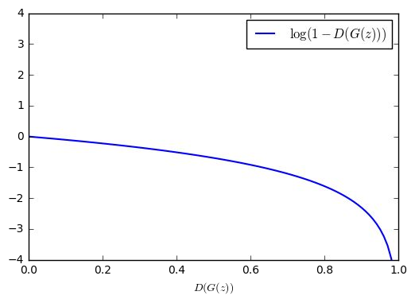
Training GANs: Two-player game
Minimax objective function:
Alternate between:
1. Gradient ascent on discriminator
Gradient signal dominated by region where sample is already good
2. Gradient descent on generator
When sample is likely fake, want to learn from it to improve generator. But gradient in this region is relatively flat!
In practice, optimizing this generator objective does not work well!
Ian Goodfellow et al., “Generative Adversarial Nets”, NIPS 2014

Slide 89

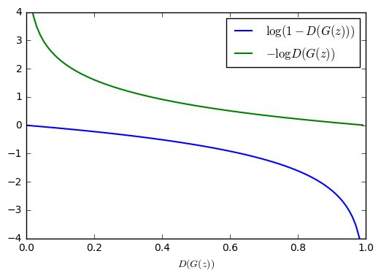
Training GANs: Two-player game
Minimax objective function:
Alternate between:
1. Gradient ascent on discriminator
2. Instead: Gradient ascent on generator, different objective
Instead of minimizing likelihood of discriminator being correct, now maximize likelihood of discriminator being wrong.
Same objective of fooling discriminator, but now higher gradient signal for bad samples => works much better! Standard in practice.
High gradient signal
Low gradient signal
Ian Goodfellow et al., “Generative Adversarial Nets”, NIPS 2014

Slide 90
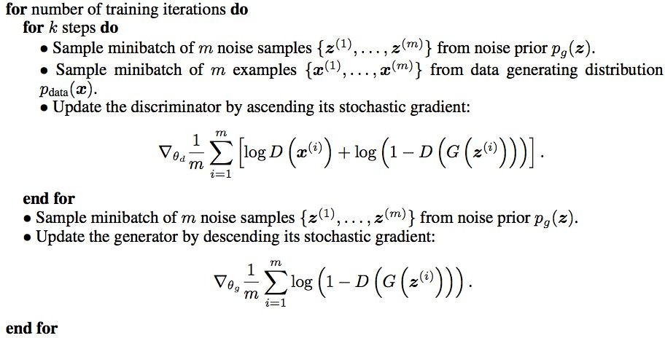
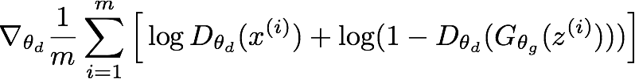
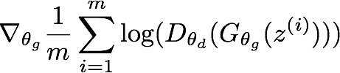
Training GANs: Two-player game
Ian Goodfellow et al., “Generative Adversarial Nets”, NIPS 2014
Putting it together: GAN training algorithm

Slide 91
Training GANs: Two-player game
Ian Goodfellow et al., “Generative Adversarial Nets”, NIPS 2014
Putting it together: GAN training algorithm
Some find k=1 more stable, others use k > 1, no best rule.
Recent work (e.g. Wasserstein GAN) alleviates this problem, better stability!

Slide 92
Training GANs: Two-player game
Ian Goodfellow et al., “Generative Adversarial Nets”, NIPS 2014
Generator network: try to fool the discriminator by generating real-looking images
Discriminator network: try to distinguish between real and fake images
Real or Fake
Discriminator Network
Fake Images (from generator)
Random noise
Real Images (from training set)
Generator Network
After training, use generator network to generate new images
z

Slide 93
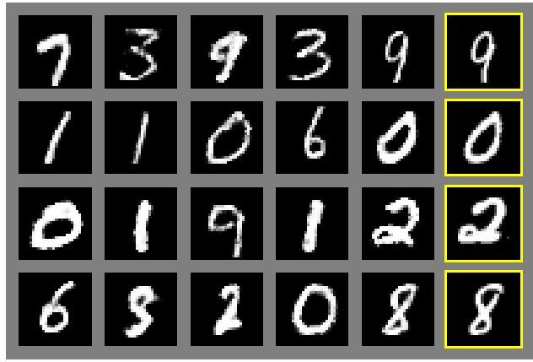
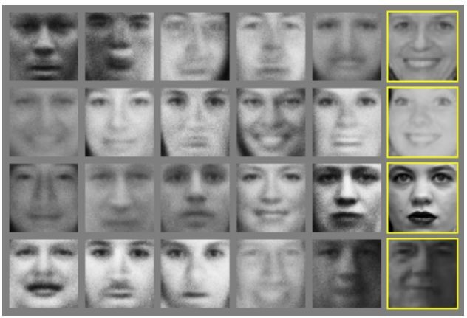
Generative Adversarial Nets
Generated samples
Nearest neighbor from training set

Slide 94
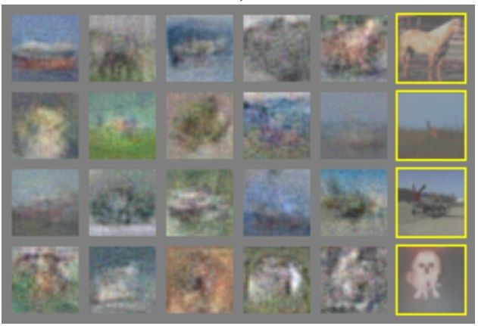
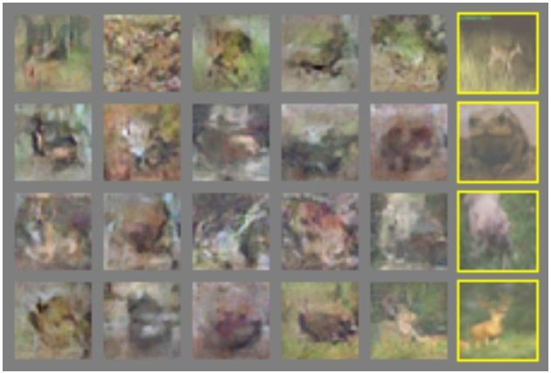
Generative Adversarial Nets
Generated samples (CIFAR-10)
Nearest neighbor from training set

Slide 95
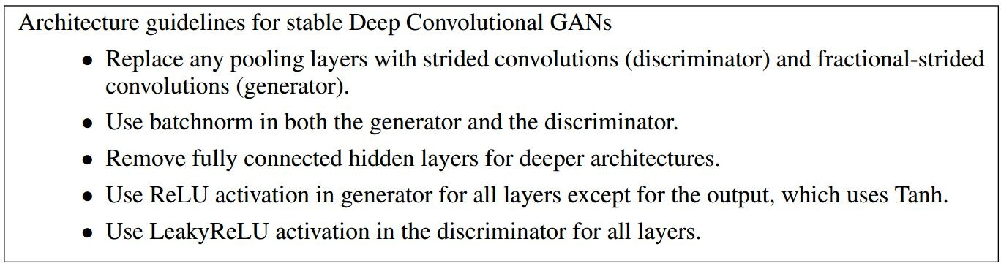
Generative Adversarial Nets: Convolutional Architectures
Generator is an upsampling network with fractionally-strided convolutions Discriminator is a convolutional network
Radford et al, “Unsupervised Representation Learning with Deep Convolutional Generative Adversarial Networks”, ICLR 2016

Slide 96
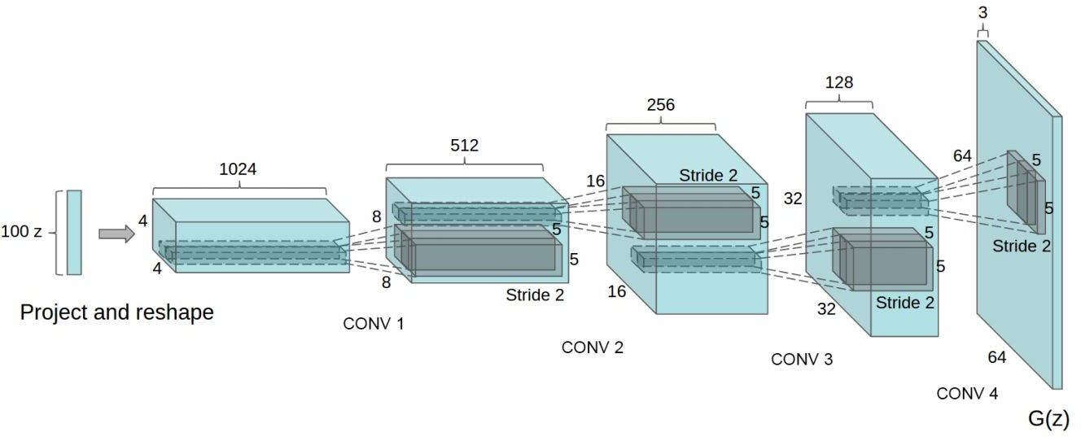
Generative Adversarial Nets: Convolutional Architectures
Generator
Radford et al, “Unsupervised Representation Learning with Deep Convolutional Generative Adversarial Networks”, ICLR 2016

Slide 97
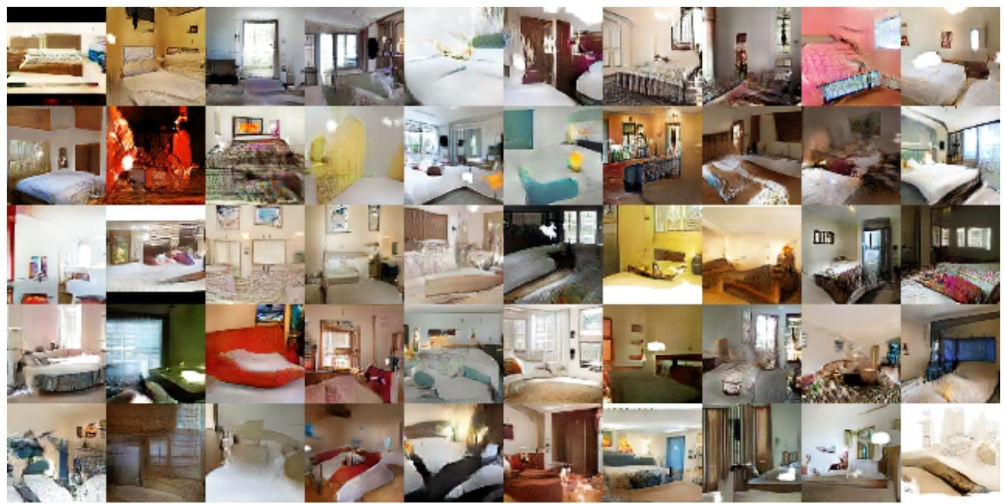
Generative Adversarial Nets: Convolutional Architectures
Samples from the model look much better!
Radford et al, “Unsupervised Representation Learning with Deep Convolutional Generative Adversarial Networks”, ICLR 2016

Slide 98
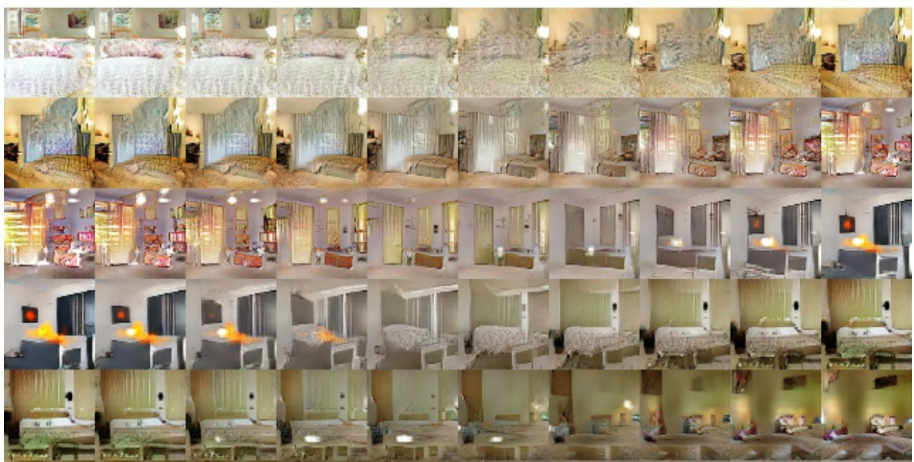
Generative Adversarial Nets: Convolutional Architectures
Interpolating between random points in latent space
Radford et al, “Unsupervised Representation Learning with Deep Convolutional Generative Adversarial Networks”, ICLR 2016

Slide 99
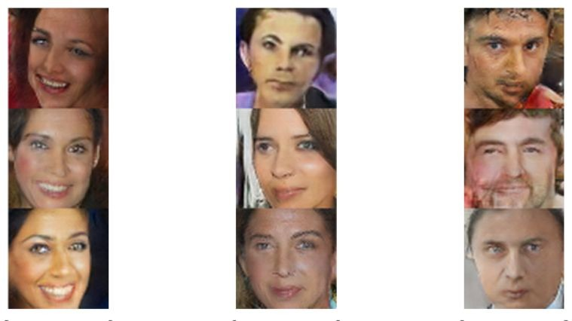
Generative Adversarial Nets: Interpretable Vector Math
Radford et al, ICLR 2016
Smiling woman Neutral woman Neutral man
Samples from the model

Slide 100
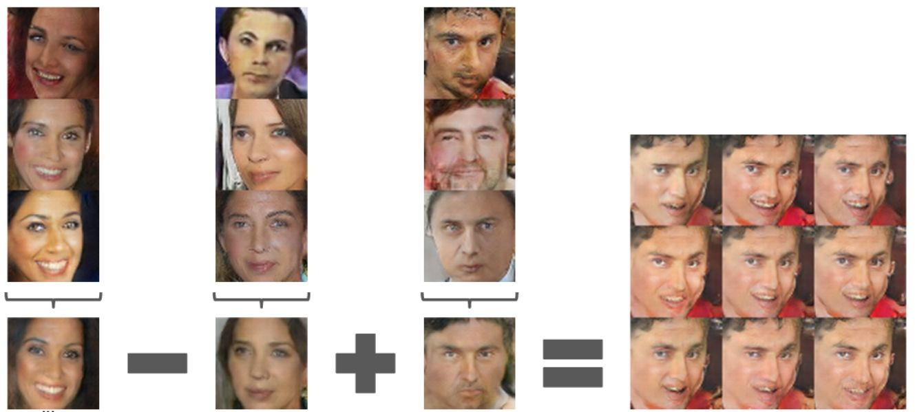
Generative Adversarial Nets: Interpretable Vector Math
Radford et al, ICLR 2016
Smiling woman Neutral woman Neutral man
Samples from the model
Smiling Man
Average Z
vectors, do arithmetic

Slide 101
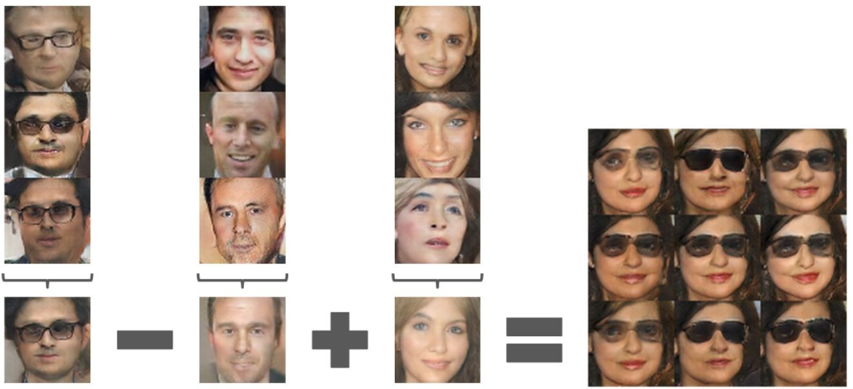
Generative Adversarial Nets: Interpretable Vector Math
Radford et al, ICLR 2016
Glasses man No glasses man No glasses woman
Woman with glasses

Slide 102
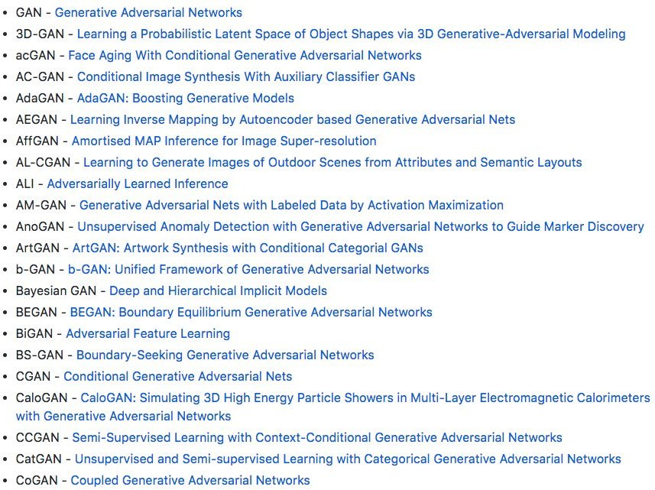
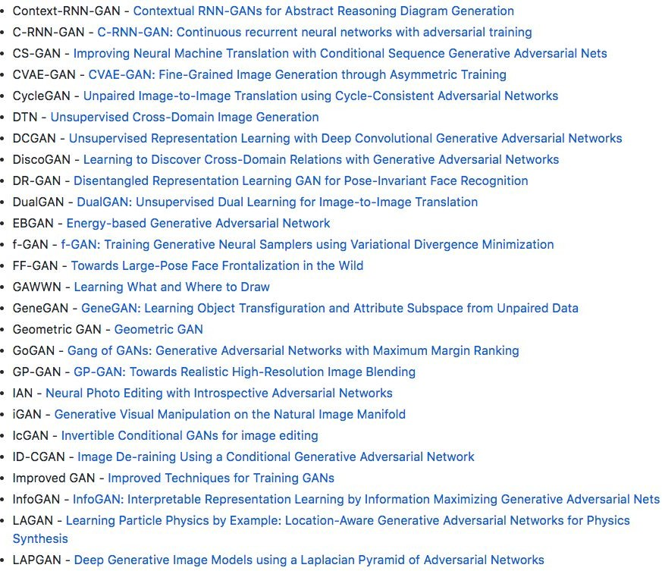
2017: Explosion of GANs
“The GAN Zoo”
See also: https://github.com/soumith/ganhacks for tips and tricks for trainings GANs
https://github.com/hindupuravinash/the-gan-zoo

Slide 103
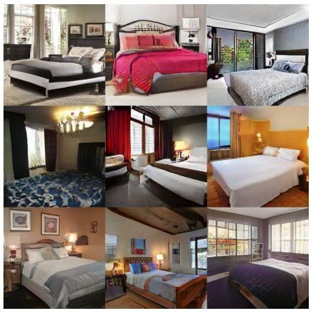
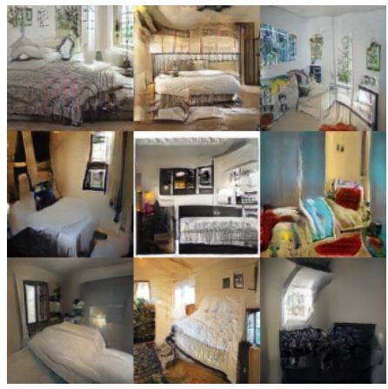
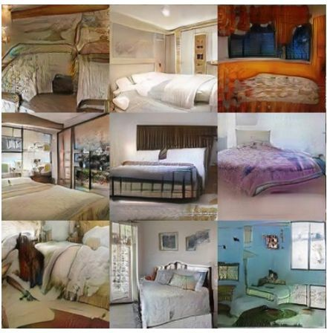
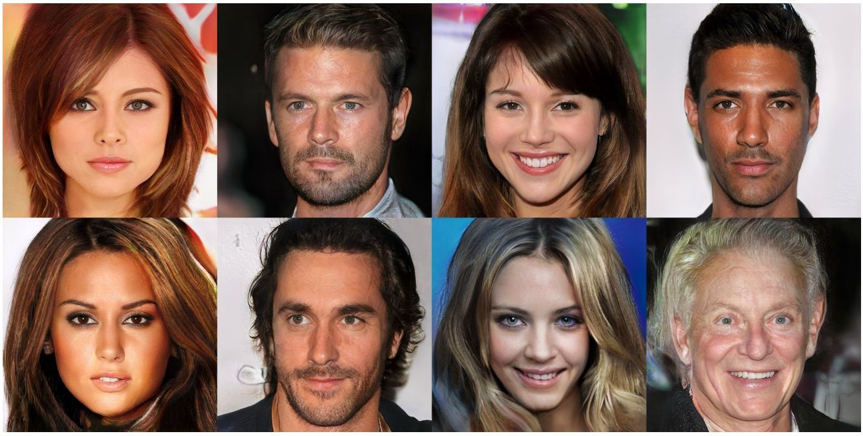
2017: Explosion of GANs
Better training and generation
LSGAN, Zhu 2017.
Wasserstein GAN, Arjovsky 2017.
Improved Wasserstein GAN, Gulrajani 2017.
Progressive GAN, Karras 2018.

Slide 104
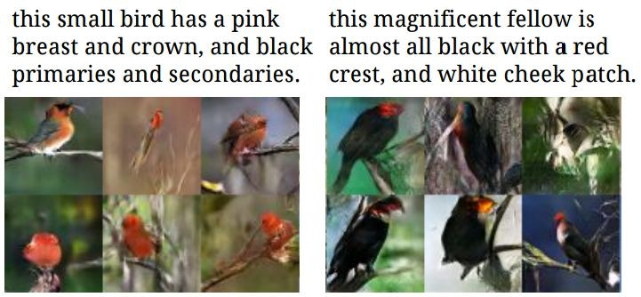
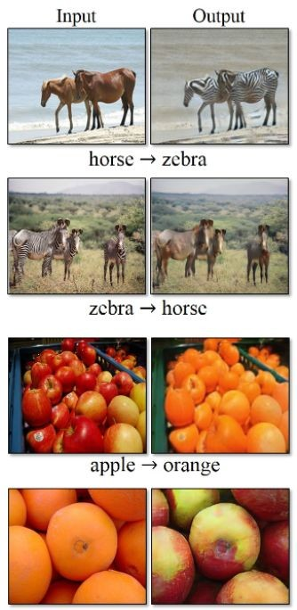
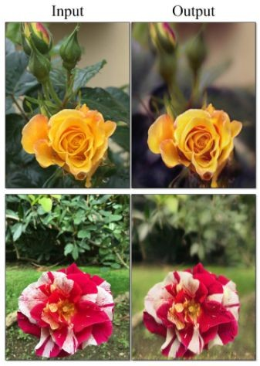



2017: Explosion of GANs
Text -> Image Synthesis
Source->Target domain transfer
Reed et al. 2017.
Many GAN applications
Pix2pix. Isola 2017. Many examples at https://phillipi.github.io/pix2pix/
CycleGAN. Zhu et al. 2017.

Slide 105

2019: BigGAN
Brock et al., 2019

Slide 106
GANs
Don’t work with an explicit density function
Take game-theoretic approach: learn to generate from training distribution through 2-player game
Pros:
Beautiful, state-of-the-art samples!
Cons:
Trickier / more unstable to train
Can’t solve inference queries such as p(x), p(z|x)
Active areas of research:
Better loss functions, more stable training (Wasserstein GAN, LSGAN, many others)
Conditional GANs, GANs for all kinds of applications

Slide 107
Taxonomy of Generative Models
Direct
GAN
Generative models
Explicit density
Implicit density
Tractable density
Approximate density
Markov Chain
Fully Visible Belief Nets
GSN
NADE
MADE
PixelRNN/CNN
NICE / RealNVP
Glow
Ffjord
Variational
Markov Chain
Variational Autoencoder Boltzmann Machine

Slide 108
Useful Resources on Generative Models
CS 236: Deep Generative Models (Stanford)
CS 294-158 Deep Unsupervised Learning (Berkeley)

Slide 109
Recap
Generative Models
- PixelRNN and PixelCNN
Explicit density model, optimizes exact likelihood, good samples. But inefficient sequential generation.
- Variational Autoencoders (VAE)
Optimize variational lower bound on likelihood. Useful latent representation, inference queries. But current sample quality not the best.
- Generative Adversarial Networks (GANs)
Game-theoretic approach, best samples! But can be tricky and unstable to train, no inference queries.

