Slide 1
Základy počítačovej grafiky a spracovania obrazu
Prípadové štúdie a aplikácie
Doc. RNDr. Milan Ftáčnik, CSc.

Slide 2
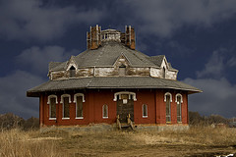
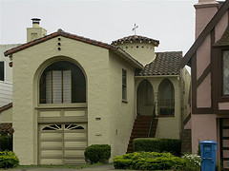
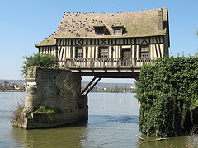
Projekt ImageNet
Odkaz je na stránke
https://www.ted.com/talks/fei_fei_li_how_we_re_teaching_computers_to_understand_pictures
 |  |  | Synset: house has bounding box Definition: a dwelling that serves as living quarters for one or more families; "he has a house on Cape Cod"; "she felt she had to get out of the house".

Slide 3
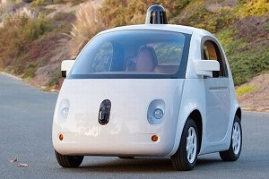
Autonómne Google auto
Odkaz je na stránke
https://www.ted.com/talks/chris_urmson_how_a_driverless_car_sees_the_road

